Slide 1
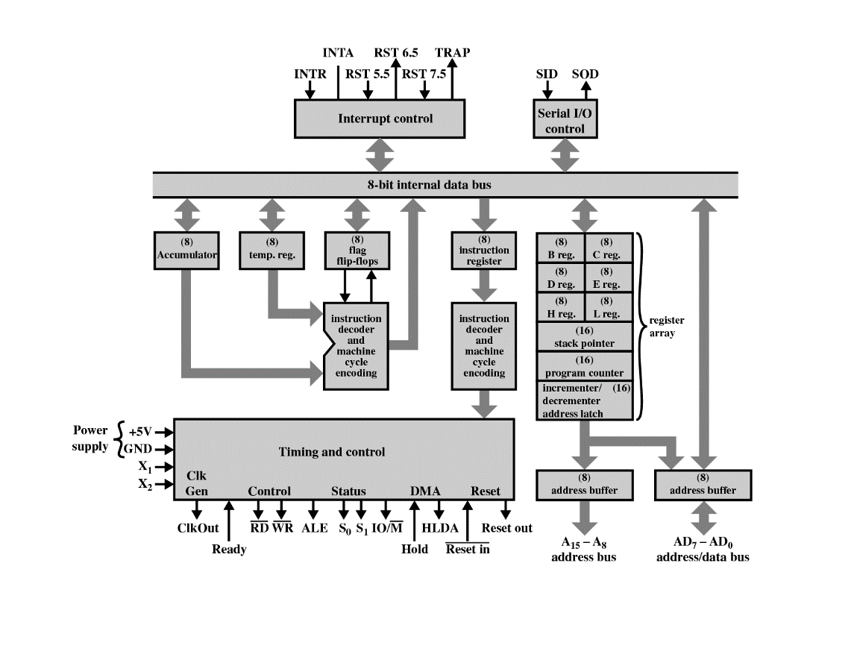
8085 MICROPROCESSOR
Presented by: Rafia Afsana Rinky
RMU, Roll - HA190107006
Department of CSE
Level 3/1

Slide 2
CONTENTS
1. What is Microprocessor
2. Intel 8085 Microprocessor
3. The Block Diagram of 8085 Microprocessor
4. Functional units of 8085 Microprocessor

Slide 3
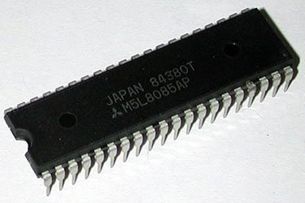
WHAT IS MICROPROCESSOR?
A microprocessor is a computer processor which incorporates the functions of a computer's central processing unit (CPU) on a single integrated circuit (IC), or at most a few integrated circuits.
The Intel 8085 is an 8- bit microprocessor produced by Intel and introduced in 1976.

Slide 4
It is a software-binary compatible with the more famous Intel 8080 with only two minor instructions added to support its added interrupt and serial input/output features.

Slide 5
INTEL 8085 MICROPROCESSOR
The Intel 8085 ("eighty-eighty five") is an 8-bit microprocessor produced by Intel and introduced in 1976.
It is a software-binary compatible with the morefamous Intel 8080 with only two minor instructions added to support its added interrupt and serial input/output features.

Slide 6
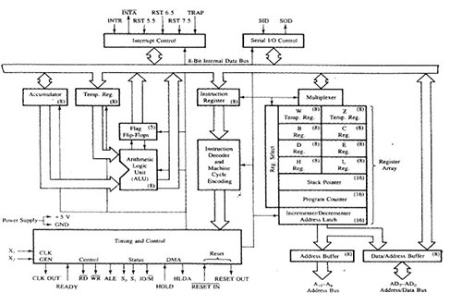
BLOCK DIAGRAM OF 8085

Slide 7
REGISTER SECTION
1. Temporary Register
2. General purpose register
3. Special purpose register

Slide 8
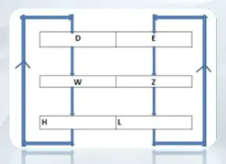
TEMPORARY REGISTER
In 8085 microprocessor,there are three temporary 8 bit register. One is used during calculation to keep data temporarily and then move it to destination ,the other two ‘W’ and ‘Z’ temporary register are used to hold data/address temporarily during execution of some instruction.

Slide 9
GENERAL PURPOSE REGISTER
B-C,D-E,H-L are the general purpose register.
This register can also be used to work in pairs to hold 16-bit data.
The H-L pairs works as a memory pointer.
A memory pointer holds the address of a particular memory location.

Slide 10
SPECIAL PURPOSE REGISTER
1. Accumulator
2. Instruction Register and Decoder
3. Program Counter
4. Stack Pointer
5. Flag Register

Slide 11
1. ACCUMULATOR
It is an 8 bit Register use to perform Arithmetic Logical Input and output Operation.
It is connected to the Internal Bus and ALU.

Slide 12
2. INSTRUCTION REGISTER & DECODER
In computing, an instruction register (IR) is the part of a CPU's control unit that holds the instruction currently being executed or decoded.
There is an Instruction Decoder which Decodes the information’s present in the instruction register for further processing.

Slide 13
3. PROGRAM COUNTER
A program counter is a register in a computer processor that contains the address (location) of the instruction being executed at the current time.

Slide 14
4. STACK POINTER
A stack pointer is a small register that stores the address of the last program request in a stack.
A stack is a specialized buffer which stores data from the top down.

Slide 15
5. FLAG REGISTER
1. Sign Flag (S): Sign flag occupies the 7th bit of the flag register which is also known as the Most Significant Bit ( MSB ).
2. Zero Flag (Z): Zero flag occupies the 6th bit of the flag register. It is set(1) when the operation performed in the ALU (Arithmetic and Logic unit) results in 0 and is reset(0) when the result is not zero.
3. Auxiliary Carry Flag (AC): If an operation performed in ALU generates the carry from D7 to next stage then CY flag is set, else its reset.
4. Parity Flag (P): If the result contains Even number of 1’s then parity exists and flag bit is set.
5. Carry Flag (CY): If the arithmetic operation finally results in a carry, carry flag is set(1). Else, it is reset(0).

Slide 16
ALU
It is not accessible by user.
The world length of ALU depends upon of an internal data bus.
It is 8 bit. It is always controlled by timing and control circuits
It provides status or result of flag register.

Slide 17
ARITHMETIC & LOGICAL SECTION
1. Instruction Decoder and Machine cycle encoder
2. Address Buffer & Data Buffer
3. Increment/Decrement Address latch etc.

Slide 18
1. INSTRUCTION DECODER & MACHINE CYCLE ENCODER
The Instruction Decoder of a processor is a combinatorial circuit sometimes in the form of a read-only memory, sometimes in the form of an ordinary combinatorial circuit.
A Machine Cycle, also called a processor cycle or a instruction cycle, is the basic operation performed by a Central Processing Unit (CPU).

Slide 19
2. ADDRESS BUFFER & DATA BUFFER
Address Buffer
It is a group of lines (wires) used to refer a physical location in memory.
It is unidirectional.
8085 has 16-bit address bus.
Data Buffer
It also called memory bus.
Used to carry the data.

Slide 20
It is bidirectional.
the width of the data bus is determined by the size of the individual memory blocks (in 8085, it is 8-bit).

Slide 21
3. INCREMENT/DECREMENT ADDRESS LATCH
This 16-bit register is used to increment or decrement the contents of program counter or stack pointer as a part of execution of instructions related to them.

Slide 22
WHAT IS BUS?
It is a set of pins, wires or signals.
Address bus: It is a computer bus architecture used to transfer data between devices that are identified by the hardware address of the physical memory (the physical address), which is stored in the form of binary numbers to enable the data bus to access memory storage.
Data bus: A data bus is a system within a computer or device, consisting of a connector or set of wires, that provides transportation for data. Different kinds of data buses have evolved along with personal computers and other pieces of hardware.
Control bus: A control bus is a computer bus that is used by the CPU to communicate with devices that are contained within the computer.
.

Slide 23
CONCLUSION
The 8085 processor was used in a few early personal computers, produced from 1977 to early-to-mid1980’s.
Now-a-days, in many engineering schools the 8085 processor is used in introductory microprocessor courses.
However with time, better quality microprocessors have been developed with greater bit processing Capability (32 and 64 bit) along with huge no of other modifications.

